Slide 1
Counselor Learning Series 2017
Health Savings Accounts & Voluntary Benefits
Providing Financial Wellness though tax advantaged medical savings accounts and asset protection strategies

Slide 2
Agenda – Health Savings Accounts
The HSA versus an HRA or FSA
What is an HSA?
Who is eligible?
Why would you want one?
What can an HSA be used for?
How does it work?
The HSA and Voluntary Benefits

Slide 3
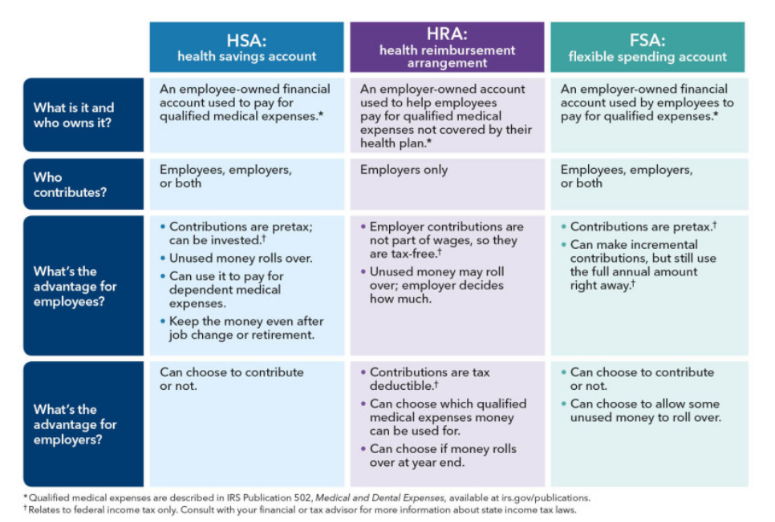
HSA versus an HRA or FSA

Slide 4



What is an HSA?
A special kind of tax-advantaged savings account for your medical expenses
Paired with a high-deductible health plan
Financial owned by the employee
Pays for current and future medical expenses
Anyone can open an HSA, as long as they:
Have health coverage through a qualified high-deductible health plan. If you don’t have this type of health plan, you CANNOT open an HSA.
Are NOT covered by any other health plan
Are NOT enrolled in Medicare
CANNOT be claimed as a dependent on someone else’s tax return.

Slide 5
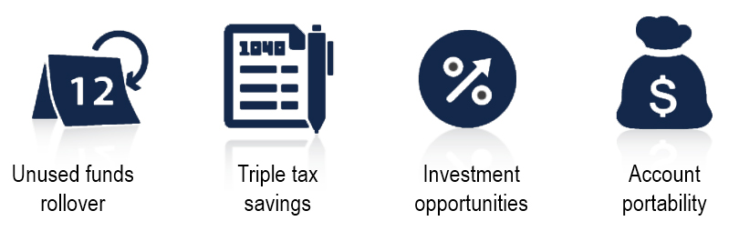
Why would you want one?
There are many special advantages to opening an HSA
Unlike Flexible Spending Accounts there is NO “use it or lose it” rule with an HSA.
Any dollars left in your account at the end of the year roll over to the next year.
It may even come with “built in” investment options.
Its portable. Unlike other medical spending accounts that are owned by your employer, the HSA belongs to you, even if you change jobs or retire.
Another advantage of the HSA is what is called a “triple tax savings”…
The money that is deposited into the account reduces your taxable income.
The balance in your account earns interest tax free, and
Any withdrawals from the account are tax free as long as the moneys is used for a qualified medical expense.

Slide 6


What can an HSA be used for?
Helps you pay for a variety of medical expenses
Health plan eligible expense
Vision and dental expenses
Over-the-counter (OTC) items
COBRA premiums
Medicare premiums (for people 65 and older)
Health Insurance while receiving unemployment
Long-term insurance
Qualified medical expenses include things that are associated with your health plan, such as:
Deductibles and Coinsurance
Vision Care
Dental Expenses
Over-the-counter supplies
Some insurance premiums

Slide 7

How does an HSA work?
Contributing to an HSA is easy
Employers and/or employees can contribute
Employer contributions belong to you and are not taxable
Pretax contributions, through payroll deduction, can be changed at any time
Post-tax contributions are an “above-the-line” deduction
Contributions can be made up to the date tax returns are due
Maximize your contributions and your savings potential
2017 Maximum Contributions:
$3,400 Employee-only coverage
Employee-only limit is the only change
$6,750 Family Coverage
55+ Catch-Up Contributions:
$1,000

Slide 8
Why Voluntary Benefits?
There is a greater financial risk associated with Consumer Driven Health Plans:
Requires higher deductible
Requires higher out-of-pocket maximums
HSA does not come fully funded

Slide 9



Voluntary Benefits
Providing a Financial “Safety Net” for employees and their family
Fully funded upon issue
Can be used for any purpose
Tax free benefit paid directly to insured
Flexible design to support CDHP
Related benefits to complete the financial wellness “picture”:
Critical Illness
Accident Plan
Hospital Indemnity

Slide 10
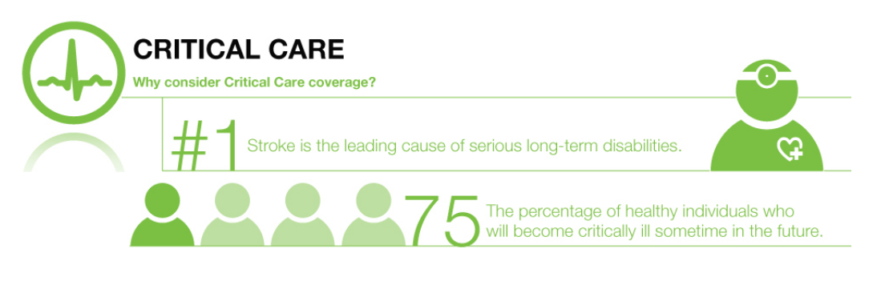
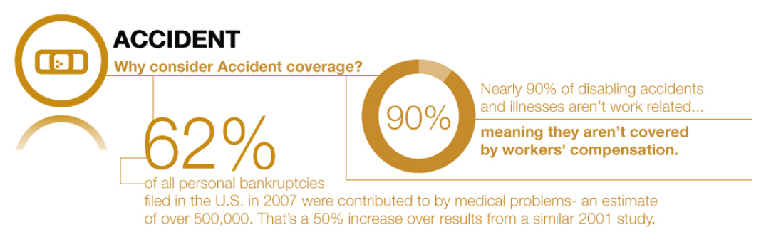
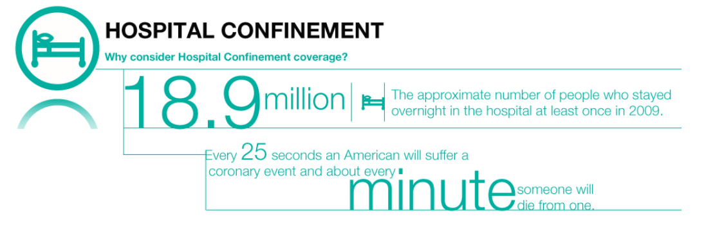
A Case for Voluntary Benefits
Provides the protection one needs in the event of a heart attack, stroke, end stage renal failure, cancer, by pass surgery or any other covered major illness.
Gives financial security in the in the event of an accident. Can provide both on and off-the-job coverage.
With substantial out-of-pocket expenses associated with a CDHP, do you have adequate discretionary funds to cover the deductible and coinsurance maximums?

Slide 11
Thank You.

